Slide 1
Desktop notifier app

Slide 2

What will be covered in this
1. Desktop Notification Introduction 2. What is Plyer?
3. What is Request?
4. What is BeautifulSoup? 5. Create a Desktop Notifier

Slide 3
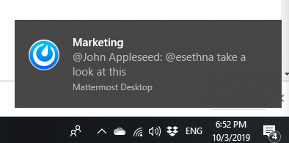
Desktop Notification
A desktop notifier is a simple application which produces a notification message in form of a pop-up message on desktop
The action of notifying someone or something.
.

Slide 4
Purpose
The purpose behind a notifications help people to remember things. It is a small piece of text which appears on the desktop or mobile screen to inform the user about the updates or any other important pieces of information.

Slide 5
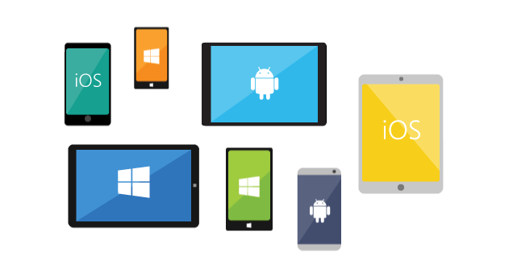
plyer
Plyer is an open source library to access features commonly found in various platforms via python. Plyer module is used to access the features of the hardware.
To install this module type the below command in the terminal.
pip install plyer

Slide 6
Requests
The requests module allows you to send HTTP requests using Python. The HTTP request returns a Response Object with all the response data.
Requests officially supports Python 2.7 & 3.5+,

Slide 7
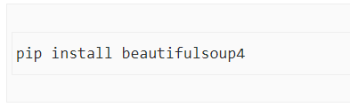
Beautifulsoup
Beautiful Soup is a Python library for getting data out of HTML, XML, and other markup languages.
It is a tool for web scraping that helps you clean up and parse the documents you have pulled down from the web.
The following command in the terminal to install Beautiful Soup:

Slide 8
Scope
Set daily tracker for COVID stats
Daily notification to take medicine.
Hourly notification to drink water.
Top news
Important updates

Slide 9
Ways to design the application
1. Customize desktop notifier.
i.e. For personal reminder.
2. Notifier that notify the user about the updates and important informations.

Slide 10
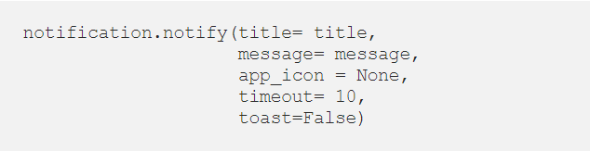
Customized desktop Notifier
In this method I simply use notification from plyer and pass the parameters using notify method.

Slide 11
Parameters of notify method
title:
message:
app_icon:
timeout:
toast:

Slide 12
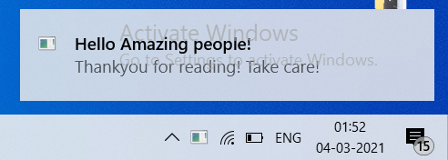
output
I am passing:
Title as Hello Amazing people!
Message as 'Thankyou for reading! Take care!'
App_icon as None
Timeout as 10 secs
Toast as False.

Slide 13
Covid Desktop Notifier
It is a simple application in form of a pop-up message to check active Covid cases with the help of requests and beautifulsoup module.

Slide 14
using requests and beautifulsoup
In this method I use notification from plyer and pass the parameters using notify method.
Requests allows you to send HTTP/requests extremely easily.
Beautiful Soup helps you pull particular content from a webpage, remove the HTML markup, and save the information.

Slide 15
For this I request for govt. site to check the active Covid cases.ie. https://www.mohfw.gov.in/
With the help of BeautifulSoup I parse the html pages from the requested url and find the required result.

Slide 16
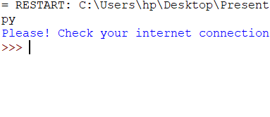
output
To get output from this method first make sure the internet connection is enable otherwise it will not generate any output because the data is fetched from the requested URL.

Slide 17
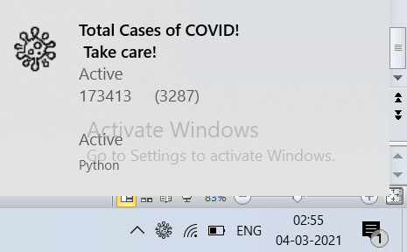
Output
Output when the requests method is sucessfully get the data from the requested URL.

Slide 18
Output
Output when the requests method is sucessfully get the data from the requested URL.

